Slide 2

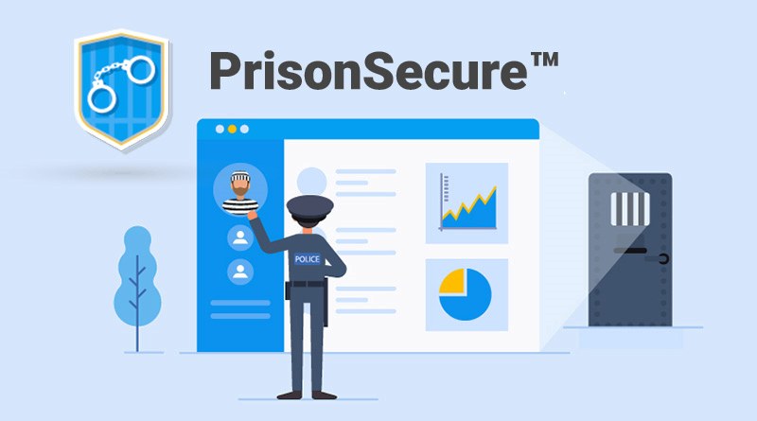
Project Title
Prisoner Surveillance Setup

Slide 3

Submitted By:
Name | Course | Roll No. | SAP Id
Aditya Sharma | BFSI | R133218002 | 500069141
Rishav Singh | BFSI | R133218035 | 500071526
Ritul Priya | BFSI | R133218020 | 500069262
Under the guidance of:-
Dr. Bhupesh Kumar Dewangan
Assistant Professor (Senior Scale), SOCS
Department Of Informatics
SCHOOL OF COMPUTER SCIENCE
UNIVERSITY OF PETROLEUM AND ENERGY STUDIES
Bidholi Campus, Energy Acres,Dehradun-248007

Slide 4
Index
Serial No. | Contents | Slide No.
1. | Abstract | 5-6
2. | Introduction | 7-8
3. | Motivation | 9
4. | Problem Statement | 10
5. | Objectives | 11
6. | Literature Review | 12-15
7. | Methodology | 16-25
8. | Future Scope | 26
9. | Plan of Work | 27
10. | System Requirements | 28
11. | References | 29

Slide 5

Abstract
Designed to compact the current security framework to minimize the time utilization for data retrieval.
Equipped with a login constraints for any data modification.
Time stamping for every login in the system.
Three interface views in the system which are admin, jail, and inquiry.
All the interface view will have different accessibility according to the user.

Slide 6
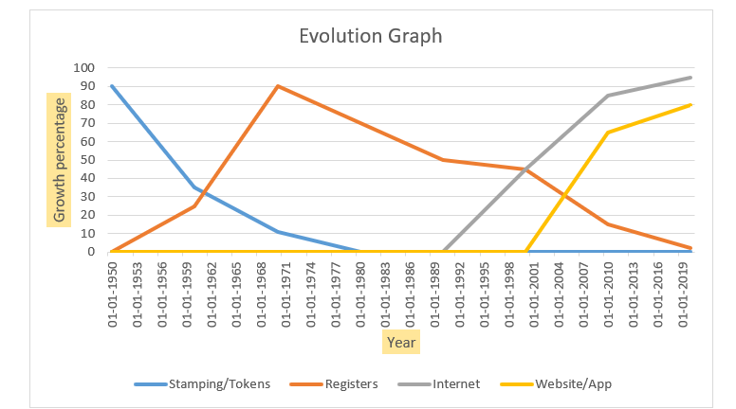
Evolution Of Prisoner Set-up
Scale:
X axis: Growth Percentage
Y axis: Year
Fig .1 Evolution in growth of prison setup
The above graph is between development in percentage and years. Basically,
this graph shows that how prison management era is increasing year by year \
in different Sectors

Slide 7

Introduction
A set up that is made for the Central level data where many tasks can be performed.
For the security layer, we have given grant access to the interfaces according to their need.
There will be three interfaces in this setup which are :
Administration Login
Police Login
Jailor Login.
Three login attempts will be provided for all the above three interfaces.
The user can also fetch the required document’s soft copy in the different formats.

Slide 8

Accessibility Distribution
Log-in
Administration Login
Police Login
Jailor Login
Prisoner Entry
Prisoner Attendance
Release Prisoner
Prisoner Details
Search Prisoner
Prison File
Log-in Record
Fig.2: The accessibility distribution of the Logins

Slide 9

Motivation
Reduction in the extra time consumptions for retrieval of data from any respective branch.
To use a more effective method than the previously used methods for the security of crime branch.
Due to the feasible usage of the system, the portability will be increased.
To learn the Object-Oriented Programming (OOPs) concepts and algorithms.
This is basically for the learning purpose which will enhance our knowledge and skills for future projects.

Slide 10

Problem Statement
As per the present scenario, retrieving any details of criminal is a time taking process and to resolve this we are building a single platform prison surveillance set up that will help in improving the portability and security of the current system transforming the current state level setup to a single platform which will be central level accessible.

Slide 11


Objectives
To create a single platform prisoner surveillance system.
Sub Objectives
Different interfaces for the user.
To fetch the details of prisoner from the records.
To apply login credentials inside the system
To apply Naive algorithm for searching the prisoner.
Time stamping on successful login.
Integration of all the interfaces in a system.

Slide 12

Literature Review
In Paper[1] named as An object oriented intelligent tourist advisor system by C.H.K. Tsang,Dept. of Computer. & Math., Hong Kong Tech. Coll., Hong Kong M.H.C. Woo C. Bloor School of Computing and Information Systems, University of Sunderland, UK.
The paper describes the design and development of an expert system for a tourist information center. The expert system was built to recommend a suitable travel schedule that satisfies user input constraints such as time period, budget and preferences. Tourist center officers need to answer similar queries in their day-to-day work and could be replaced by an intelligent tourist advisor system.

Slide 13
Paper 2
In Paper [2] named as File Structures : An Object-Oriented Approach with C++ by Michael J. Folk Bill Zoellick Greg Riccardi which introduces the primary designed issues that characterize file structure design and notions of file structure literacy and of a conceptual toolkit for file structure design along with Introduction to file structure concepts dealing with reading , writing, field, record entries , inheritance, encapsulation etc.

Slide 14
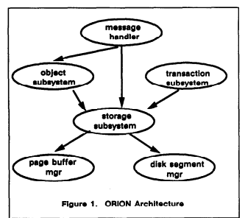
Paper 3
In Paper [3] named as Multimedia Information Management in an Object-Oriented Database System by Darrell Woelk Won Kim.
This paper describes the implementation of the Multimedia Information Manager (MIM) in the ORION object-oriented database system which is operational at MCC. We describe design objectives and implementation techniques that have satisfied the design objectives.
Fig 3. Orion Architecture
¹ Source - The above picture shows the graph of management system made in Object-Oriented Programming -https:cloudfront.net

Slide 15
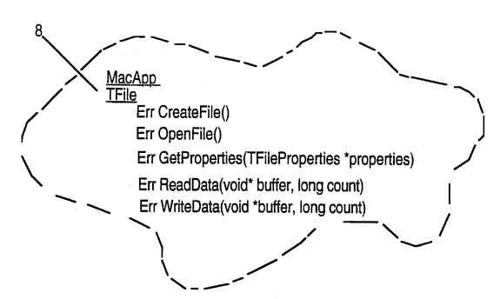
Paper 4
In Paper [4] named as Extensible object-oriented file system by Bryan P. Atsatt, Earsh K. Nandkeshwar, Michael J. Seilnacht, Hemantkumar A. Thakkar, George R. Turner and Roger R. Webster.
An object-oriented file system in an object-oriented operating system includes a file system entity class that is subclassed into a volume, directory and file subclass. These classes encapsulate standard file system properties such as name, creation date, and size, as well as standard operations such as create, open, close, and property accessors.
Fig 4. Extensible Object Oriented System
¹ Source - The above picture shows the extensible object-oriented file system - https://patents.google.com

Slide 16
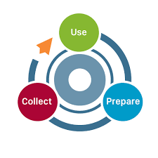
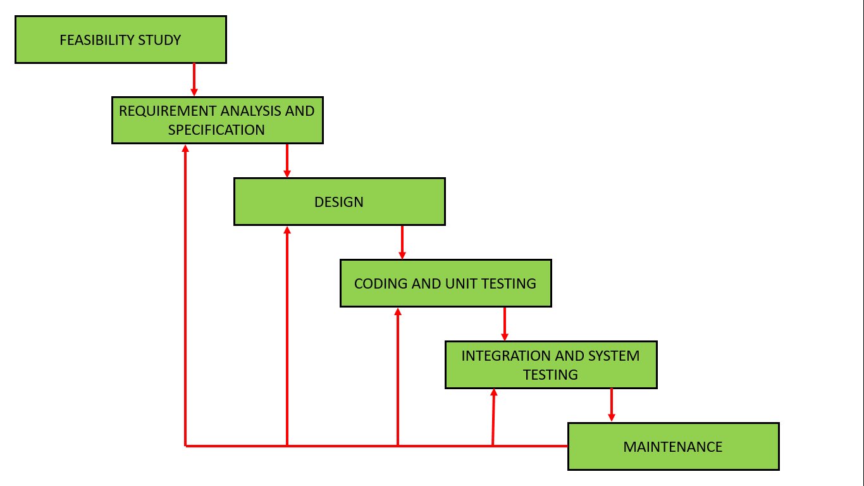
Methodology
We are using the iterative waterfall model for our project.
Fig 5. Feedback paths introduced by the iterative waterfall model are shown in the figure. ¹
¹ Source - The above picture shows the stages of iterative waterfall model retrieved from - https://www.geeksforgeeks.org

Slide 17
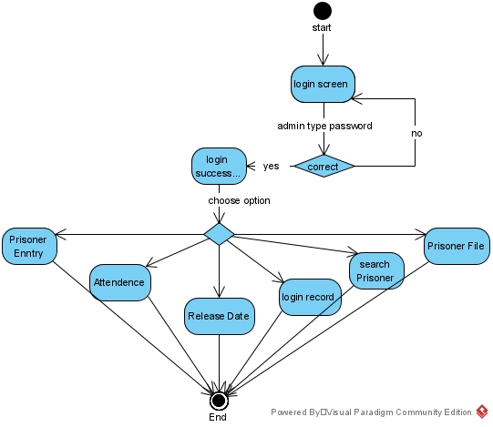
Functioning Of The System
Administration Login:
Jailor Login
Police Login
Fig 6.1 Functioning of the System

Slide 18
Concepts Used
Header Files:
Windows.h
iostream
String.h
ctime
Functions:
System(“cls”) - It clears the output screen of the program.
Time()- It returns the current time
Date()- It returns the current date
System(“pause”)- This is a Windows-specific command, which tells the OS to run the pause program.

Slide 19
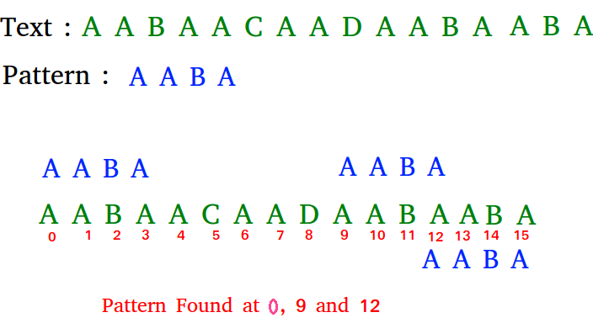
Algorithm
Naive Algorithm
It checks for all character of the main string to the pattern.
We can find substring by checking once for the string.
It also does not occupy extra space to perform the operation.
Fig 7. Naïve Algorithm Example
¹ Source - The above picture shows the example of Naïve Algorithm - https://www.geeksforgeeks.org

Slide 20
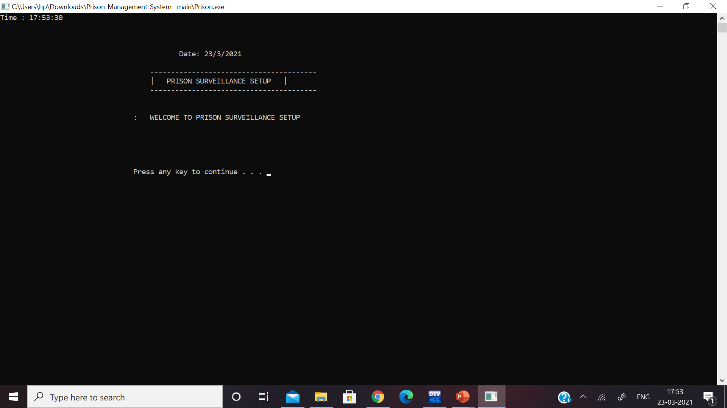
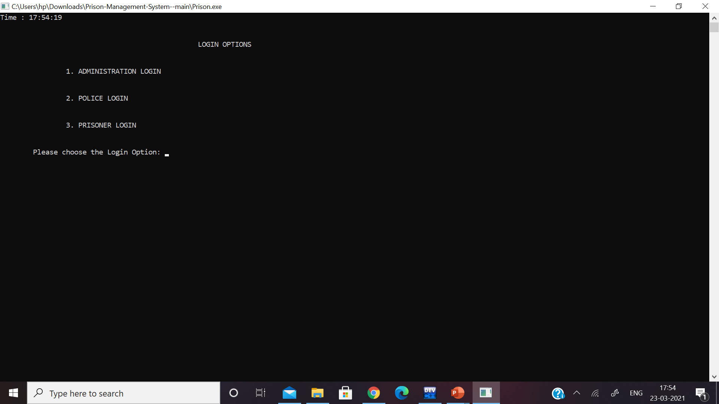
Outputs
Fig 8.1: Output of the opening window
Fig 8.2: Output of the Main window

Slide 21
Pseudocode Of Administration Login
Step 1:- Import all the header files.
Step 2:- Declare main function
Int main ();
Step3 :- Display Login options .
Cout << 1. Administration login
2. Police login
3. Jailor login
Cin >> 1.
Step 6:- declare variables
Char username, password;
Int try1;
Step 7:- Admin input user name and password
Cin >> username
Cin >> password
If ( user name = “user” && password = “ admin123”)
Then { access is granted
}
Else {
no. Of attempts remain : “ 3- try1”;}
If ( try1 >= 3)
{ no permission to enter the system }
Step 8:- After access to the system
Functions: 1. Set data
2. details
3. Release
4. Attendance
5. Search Prison
6. Prison File
7. Exit
8. Logout
Cin >> { 1,2,3,4,5,6,7,8}
Step 9 :- Logout
Step 4 :- Declare Administration login function
void Prison::Ad_Login()
Step 5 :- display welcome screen
print Welcome message

Slide 22
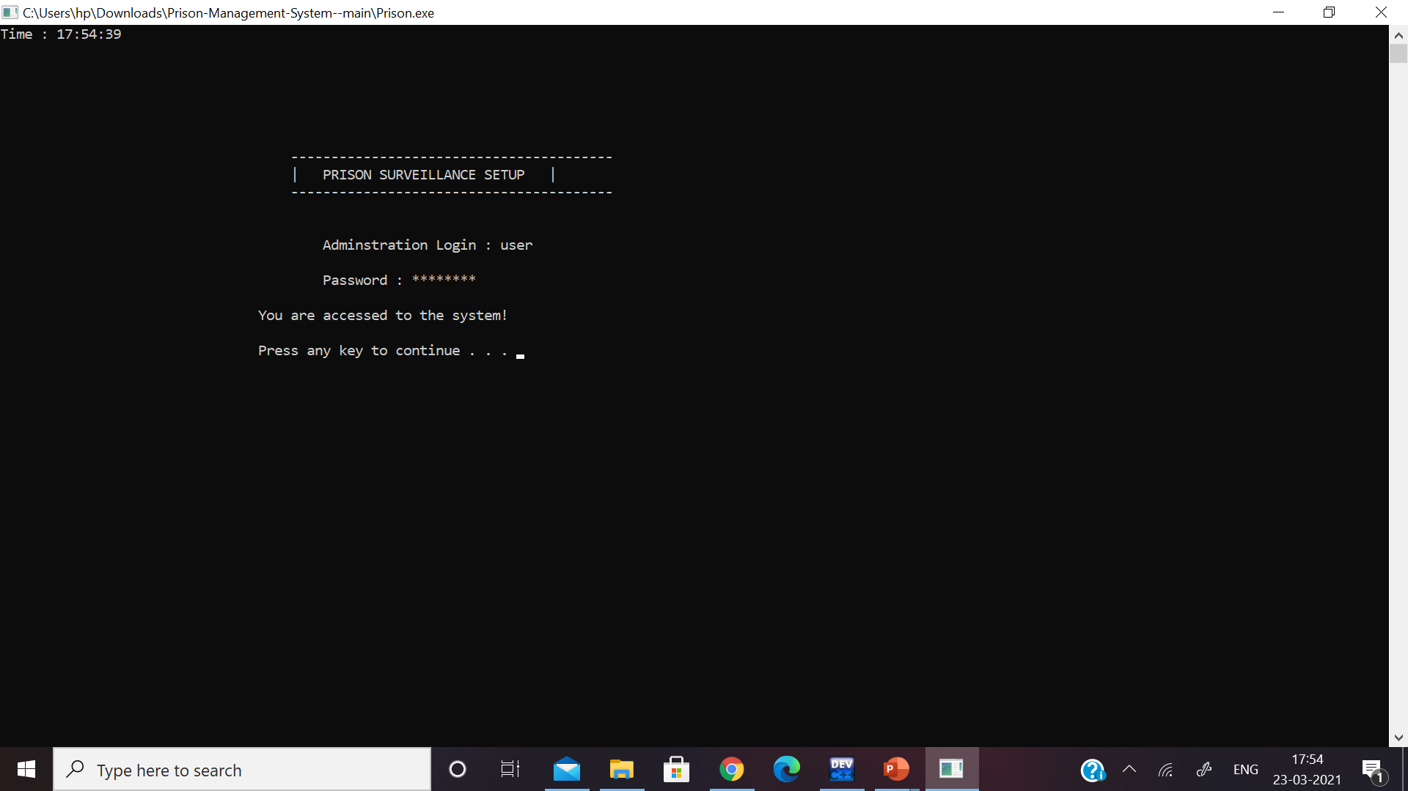
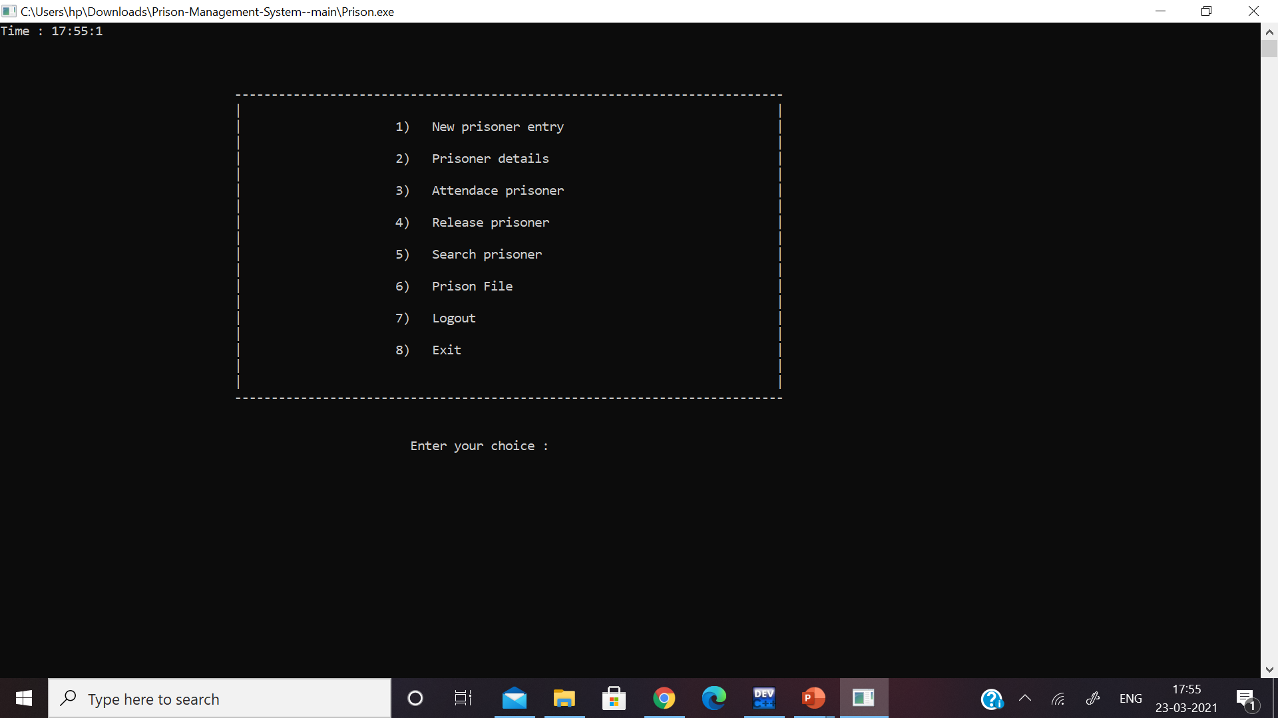
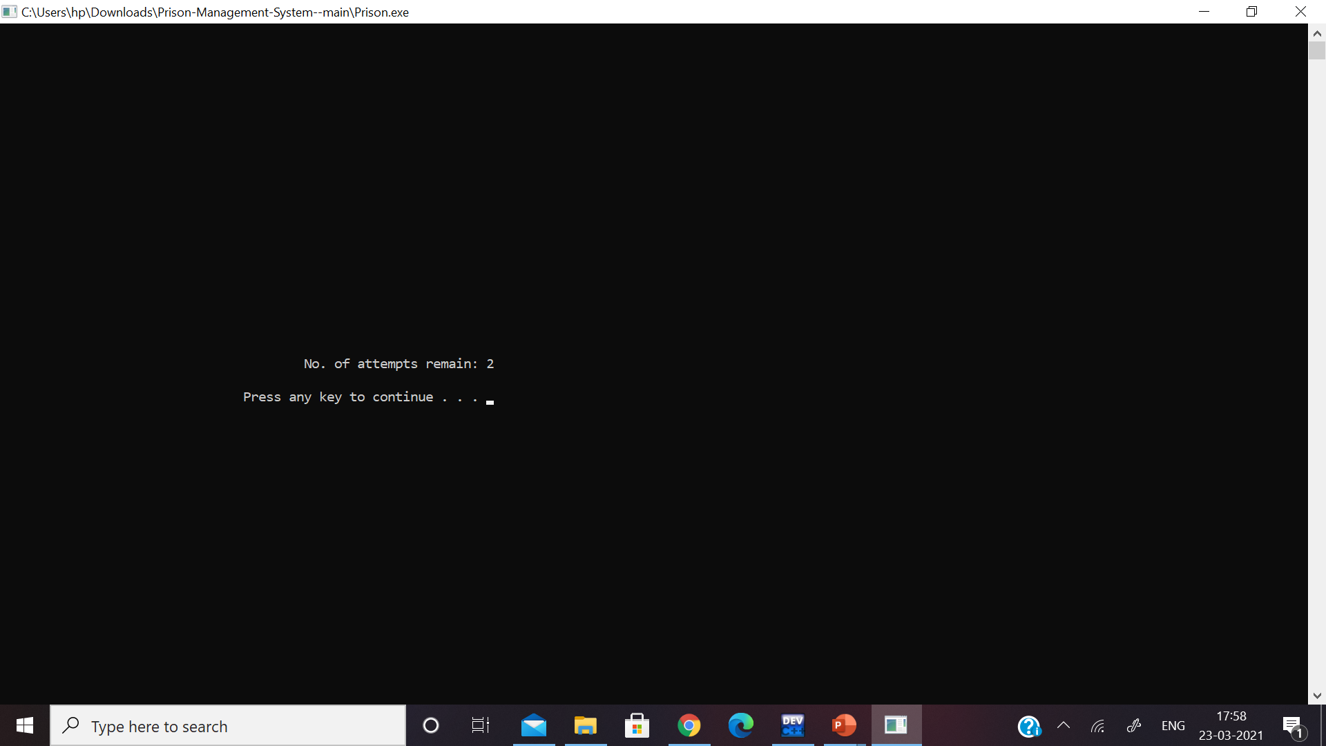
Output
Fig 9.1: Output of the Administration Login
Fig 9.3: Output of the Functions In the Administration Login
Fig 9.2: Output of the Failed attempt in Administration Login

Slide 23

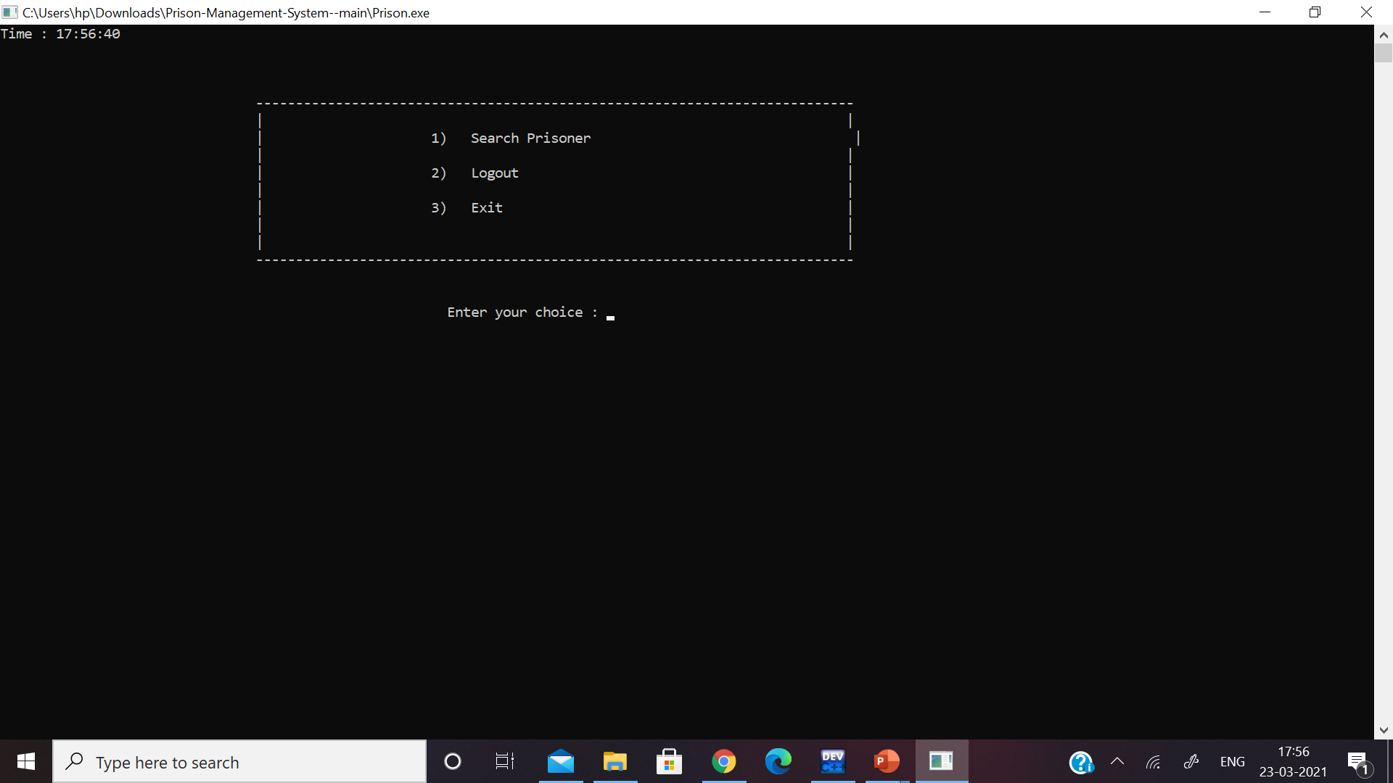
Output
Fig 9.1: Output of the Administration Login
Fig 10.1: Output of the Police Login
Fig 10.2: Output of the functions in Police Login
Pseudocode

Slide 24

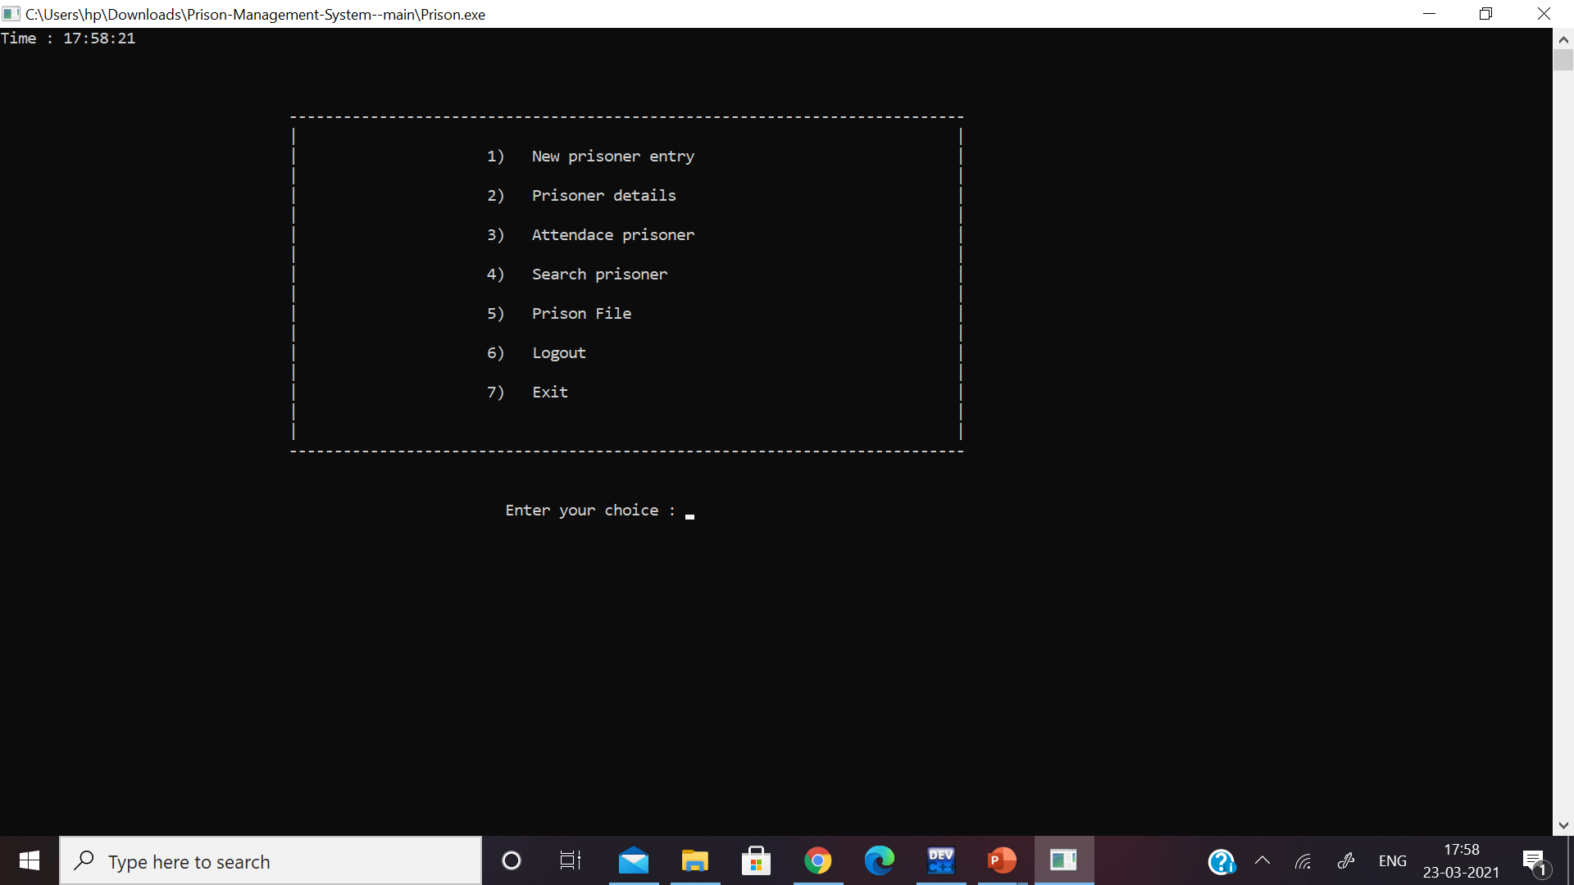
Output
Fig 11.1: Output of the Jailor Login
Fig 11.2 : Output of the functions Jailor Login
pseudocode

Slide 25

Challenges Faced
Implementation of Naïve Algorithm.
Implementation of real time stamping on every interface window.
Creating and integrating all the three interfaces.
Implementation of Secured login for every interface.
For storing the Details so that the data won’t get lost after closing the game

Slide 26

Future Scope
This setup can be converted in Application to increase the portability of the system.
The induction of One-Time Password (OTP) for every login attempt.
To reduce the fraud of fake identities during the investigation.
The installment of fingerprint scanner device along with the system.

Slide 27

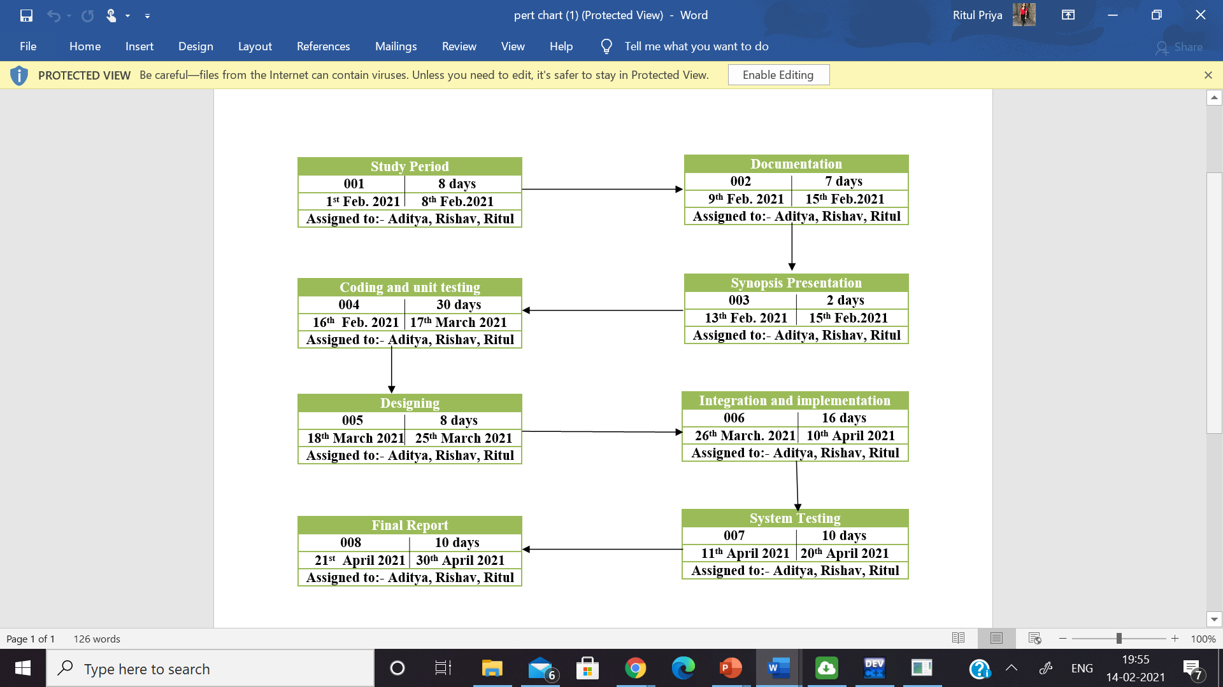
Plan of Work
Pert Chart:

Slide 28

System Requirements
Software Requirements
Name of Component | Specification
Operating System | Windows 10
Front End | C++ language
IDE Required | Dev C++
Hardware Requirements
Name of Component | Specification
Processor | Intel® Core™ i5-8250U CPU @ 1.60 GHZ 1.80 GH
RAM | 4 GB
Hard Disk | 1 TB

Slide 29
References
[1] C.H.K Tsang, M.H.C Woo, C. Bloor. "An Object Oriented intelligent tourist advisor system“ https://ieeeexplore.org L.A – 12-02-2021 5:33 PM
[2] Michael J. Folk, Bill Zoellick, Greg Riccardi “An Object-Oriented Approach with C++”https://books.google.co.in L.A – 12-02-2021 6:07 PM
[3] Darrell Woelk, Won Kim “Multimedia Information Management in an Object-Oriented Database System” www.cloudfront.net – 12-02-2021 6:45 PM
[4] Bryan P. Atsatt, Earsh K. Nankeshwar, Michael J. Seilnacht, George R. Turner “Extensible Object-Oriented File system” https://patents.google.com – 13-02-2021 2:00 PM
[5] Tromp, J., Steed, A. & Wilson, J. R. (2003). Systematic usability evaluation and design issues for collaborative virtual environments. Presence, 12:3, 241-267https://www.researchgate.net L.A – 30-11-2020 4:30 PM
[6] https://pdfs.semanticscholar.org – 13-02-2021 4:50 PM
[7] Sayan K. Pal “Iterative Water Fall method” https://www.geeksforgeeks.org L.A – 13-02-2021 7:20 PM
[8] National Institute of correction “Prison Security ”https://nicic.gov L.A – 15-02-2021 5:30 PM
[9] Android Authority “Fingerprint Scanner working principle ”https://www.androidauthority.com L.A – 15-02-2021 7:00PM
[10] Dr. L.P RAJU “Historical Evolution of Prison System in India”www.worldwidejournals.com L.A – 15-02-2021 7:59 PM
[11] ] “Overview of Prisons in India” home.rajasthan.gov.in L.A – 15-02-2021 8:30 PM

Slide 30


